Slide 1
CPSC 351
Operating Systems Concepts
Introduction

Slide 2
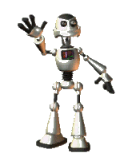
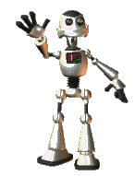
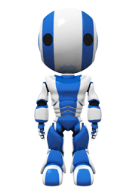
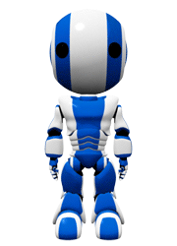

What is she talking about? What is an OS?
Hi, my name is 351
What OS do you have?
Waiting for your answer …
My name 153

Slide 3
Agenda
Operating Systems, what are they? What do they do?
Computer Structure
Operating System Functions
Process Management
Memory Management
Storage Management
I/O Management
Protection and Security
Types of Operating Systems

Slide 4
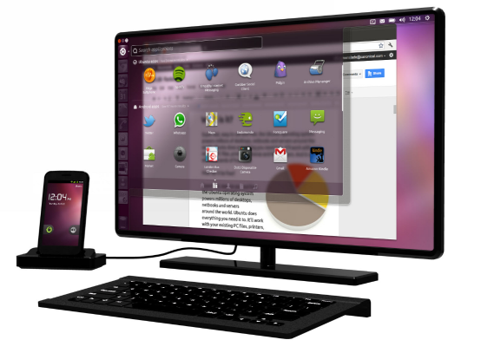
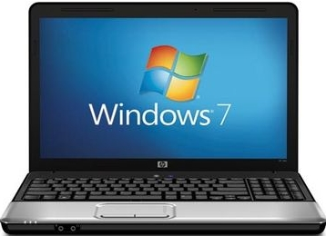
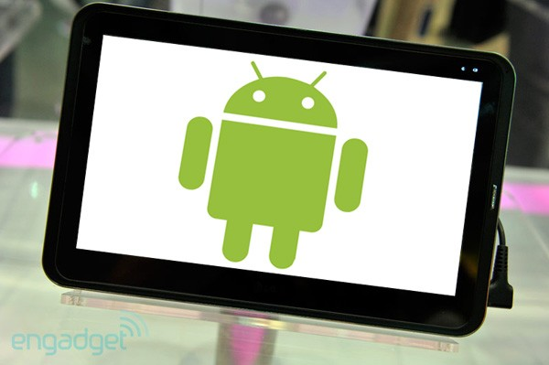
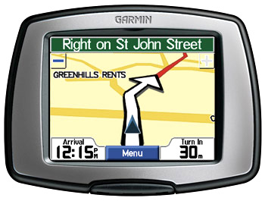
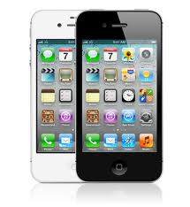
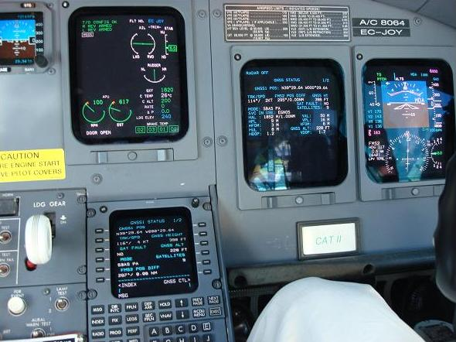





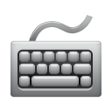

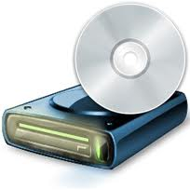
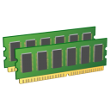
Operating System (OS)
What is an OS?
acts as intermediary
hardware
computer users
Goals?
Why a need?
Execute user programs and simplify user problem solving
Increase the usability of computers
Use the computer hardware in an efficient manner

Slide 5








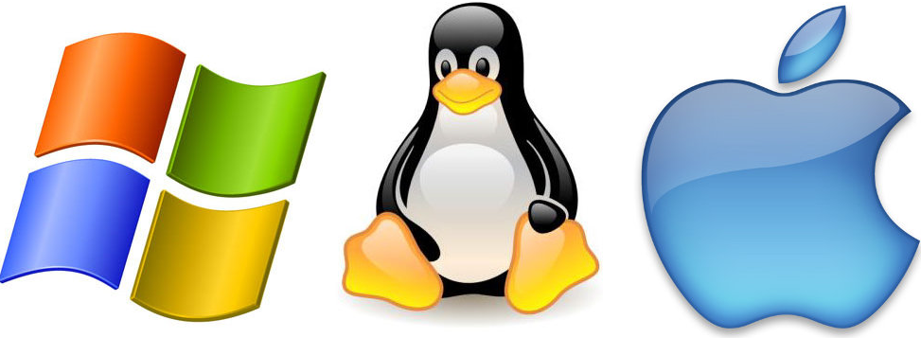
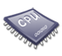
Computer System Structure
Components of a computer system: application programs, operating system, computer hardware and users
User
1
User
2
User
3
…
User
n
People, machines, other computers
Application 1
Application 2
Application 3
Application n
Solves users’ computing problems
Defines ways in which system resources are used
System and application programs
Operating System
Controls and coordinates use of hardware among various applications and users
Similar to government ⬅➔OS serves no useful function when by itself
OS only provides an environment in which user programs can do useful work
Hardware (CPU, memory I/O devices)
provides basic computing resources (CPU, memory, I/O devices, …)
OS provides the means for proper use of system resources: hardware, software, and data
Notes:
Can also view a computer system as consisting of hardware, software, and data

Slide 6


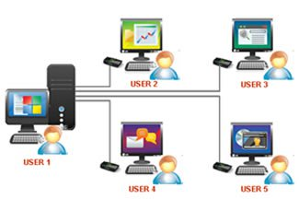
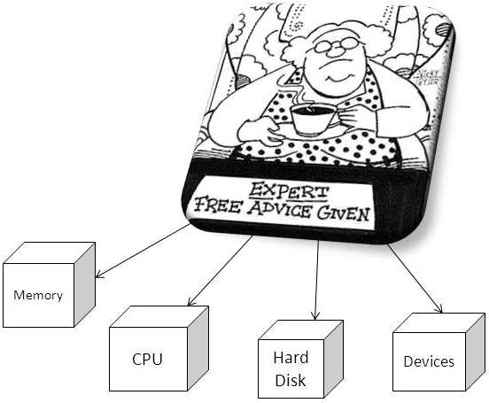
Perspectives and Roles of OS
User’s perspective
OS role is to make computers easier to use and simplify problem solving
Most users want convenience, ease of use and good performance
Interact with OS using keyboard, monitor, mouse and GUI
Don’t care about resource utilization
Multiple users connect to a mainframe computer using terminals
- Want systems that are designed to maximize resource utilization and fair sharing of resources among users
System’s perspective
Resource allocator: allocates and manages hardware resources: CPU time, memory space, disk space, and I/O
Control program: manages the execution of user programs
Notes:
OS is a resource allocator
Manages all resources
Decides between conflicting requests for efficient and fair resource use
OS is a control program
Controls execution of programs to prevent errors and improper use of the computer

Slide 7
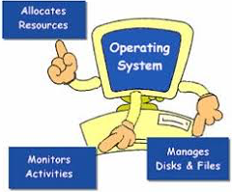
Operating System Definition Summary
No universally accepted definition!
A program running at all times on the computer ➔ the kernel
Manages computer’s hardware resources
Provides basis for application programs
Acts as an intermediary between user and hardware

Slide 8
Overview of OS Functions
Process Management
Memory Management
Storage Management
I/O Management
Protection and Security

Slide 9
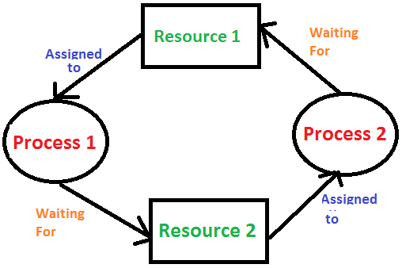
Process Management (1)
Process: a unit of work within the system
Program versus Process
Program: is a set of instructions (a passive entity)
Process: a program in execution (an active entity)
Processes require resources to run:
CPU, memory, I/O, files
Initialization data
Operating system must
Act as an intermediary between the process and the rest of the system
Allocate resources when the process starts, manage them while it runs, and reclaim them when the process terminates
Multiplex resources among multiple processes
Provide mechanism for
suspending/resuming a process
process synchronization
inter-process communications
deadlock handling

Slide 10
Process Management – OS as intermediary
Acts as an intermediary between the process and the rest of the system
Restricts processes from accessing hardware directly
If a process needs to access hardware such as opening a file on the disk, the process must request OS to perform the access on the process’s behalf
Shifts the burden of dealing with hardware characteristics from the application developers to the OS
Allow OS to enforce order, e.g., deny invalid/unauthorized accesses

Slide 11
Process Management – System Calls
OS exposes a set of system calls – functions which processes can use to request services from the operating system
Read file from the disk
Send data over the network
Send message to another process
Example
sys_open(): opens a file
sys_close(): closes the file
sys_read(): reads from file
sys_write(): writes to file
Linux system calls are defined in part of the operating system, the system call table

Slide 12
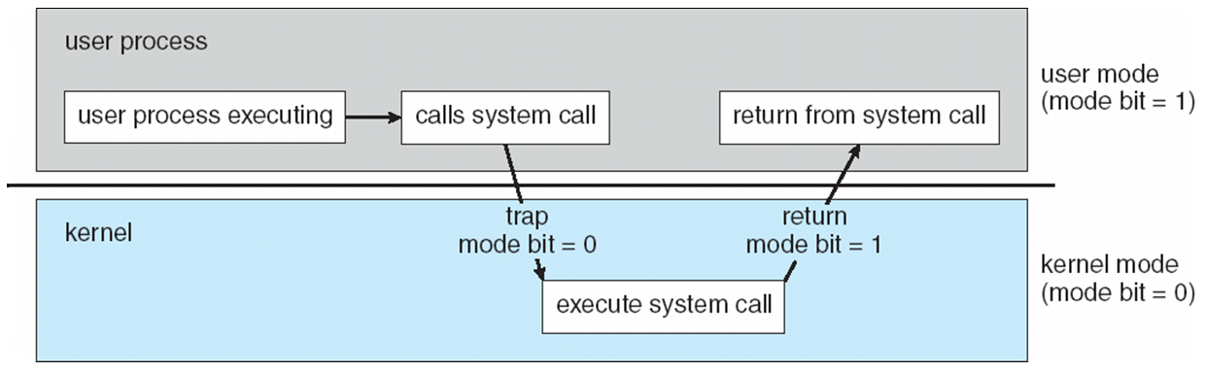
Process Management – Dual Mode Operation
A typical computer supports two modes of execution:
User mode (unprivileged mode) - when a process is executing
Allows the process to execute only unprivileged instructions e.g., addition, subtraction, logical operations, …
CPU restricts execution of privileged instructions (e.g., instructions for directly accessing hardware, managing OS timers, …)
Kernel/system mode (privileged mode) - when the OS is executing
CPU allows execution of privileged instructions
Notes:
Process management techniques are discussed in chapters 3 through 5

Slide 13
Overview of OS Functions
Process Management
Memory Management
Storage Management
I/O Management
Protection and Security

Slide 14
Memory Management
Main Memory
A large array of bytes or words where each byte or word has its own address
The only large storage directly accessible by the CPU
To execute a program all or part of the instructions must be in memory
All or part of the data that is needed by the program must be in memory
Memory management determines what is in memory and when
several programs are usually kept in memory ➔ optimizing CPU utilization and computer response to users
Memory management activities include
Keeping track of which parts of memory are currently being used and by whom
Deciding which processes (or parts thereof) and data to move into and out of memory
Allocating and de-allocating memory space as needed
Notes:
To improve both the utilization of the CPU and the speed of the computer’s response to its users, general-purpose computers must keep several programs in memory, creating a need for memory management
Memory management techniques are discussed in chapters 8 & 9

Slide 15
Overview of OS Functions
Process Management
Memory Management
Storage Management
I/O Management
Protection and Security

Slide 16
Storage Management (1)
For convenience, the information on the storage device is abstracted into units called files
File: collection of related information defined by its creator
Operating system file management services:
Creating and deleting files
Creating and deleting directories (i.e., collections of files)
Supporting primitives for manipulating files and directories
Mapping files onto secondary storage
File Backup
Mass-storage (disk) management:
Managing free space
Storage allocation
Disk scheduling (i.e., managing multiple operations that read/write from/to the disk)

Slide 17
Storage Management (2)
Caching: temporarily store data/instructions in faster storage (i.e., cache) and access them from there
Price
Speed
Must ensure data consistency along all levels of the hierarchy
Notes:
Algorithms for software-controlled caching are discussed in chapter 9

Slide 18
Overview of OS Functions
Process Management
Memory Management
Storage Management
I/O Management
Protection and Security

Slide 19
I/O Management
Purpose: hide the characteristics of specific devices from the user
Example: Unix I/O subsystem provides
Functionality to manage data buffering, caching, and spooling
A general device driver interface
Drivers for specific hardware devices (that know how to control the specific device)
Example: How Unix/Linux I/O subsystem provides uniform interface for wide range of devices
Code below works on many different devices
// Linux abstracts devices as files; application developers can
// read/write data to/from devices just like reading/writing files.
// Open the device (just like opening a file!)
int fd = open(“/dev/somedevice”);
// Write 10 integers to the device
for(int iCount=0; iCount < 10; ++iCount){
fprintf(fd, “%d\n”, iCount);
}
close(fd)
// Example from: http://www.cs.columbia.edu/~krj/os/lectures/L24-IO.pdf

Slide 20
Overview of OS Functions
Process Management
Memory Management
Storage Management
I/O Management
Protection and Security

Slide 21
Protection and Security
Protection: controls the access of users and processes to the system resources (e.g., memory, files, …)
Internal to the OS
Example: process A attempts to (illegally) write to the memory of process B. The operating system detects the violation and terminates process A
Security: defending the OS against external threats
Example: malware (e.g., viruses, worms, …)
Notes:
Protection-oriented system (authorized and unauthorized usage) are discussed in Chapter 14
Security in Chapter 15

Slide 22
Types of Operating Systems
Distributed Systems
Mobile Computing
Real-time Embedded Systems
Multimedia Systems
Virtual Machines
Cloud Computing

Slide 23
Distributed Systems
A collection of physically separate, networked systems that share resources
Advantages of resource sharing: increases computation speed, functionality, data availability, and reliability
Distributed systems can be interconnected via:
Local-Area Network (LAN): connects systems within a single floor room or a building or a campus
Wide-Area Network (WAN): connects buildings, cities, or countries

Slide 24
Mobile Computing
Computing on handheld smartphones and tablet computers
Sacrifice screen size, memory capacity, CPU power, in favor of portability:
This will change as mobile devices grow more powerful
Allows for applications impractical on traditional systems (e.g. laptops, desktops, …)
Navigation
Augmented reality
Many others!
Dominant OSs:
iOS: designed for Apple’s iPhone and iPad platforms
Android: runs on all sorts of devices

Slide 25
Real-Time Embedded Systems
Embedded Systems: systems dedicated to specific tasks e.g., controlling car engines, robotic arms, ...
Usually have little to no user interface
One of the most prevalent types of computers
Real-Time Systems: systems where tasks must complete within the defined timing constraints
Example: the robotic arm must stop moving before it smashes into a car it was building (not after!)
Embedded systems usually run real-time operating systems

Slide 26
Multimedia Systems
Systems specialized to deliver media content (i.e., a mix of text, video, sound, …)
Some media must be delivered within certain timing constraints

Slide 27
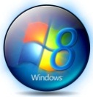
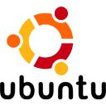

Virtual Machines
Virtual Machines (VMs): a software that can run its own operating system and applications just like a real physical system
VM1
VM2
VM3
Applications
Applications
Applications
OS
OS
OS
Virtual Hardware
Virtual Hardware
Virtual Hardware
Virtualization Software (Hosted Hypervisor)
Operating System
Hardware (CPU, memory I/O devices)

Slide 28
Cloud Computing (1)
Delivers services over the network
Three types of cloud computing services:
Infrastructure-as-a-Service (IaaS): provides hardware resources: storage, CPU, and networking services
Platform-as-a-Service (PaaS): provides hardware and platform ready for applications (e.g., a database server)
Software-as-a-Service (SaaS): provides software applications over the network
Helps reduce operating costs
Helps to improve resource utilization (by combining computing resources)
Makes it easier to tackle large scale computing problems

Slide 29
Cloud Computing (2)
Types of clouds:
Public: available to anybody willing to pay for the services
Amazon’s Elastic Cloud (EC2)
Google’s App Engine
Private: a cloud run by a company for its own use
IBM SmartCloud Foundation
Hybrid: a combination of public and private

Slide 30
Next Week
Processes – Chapter 3
In-class quiz like questions on today’s lecture
Assignment

Slide 31
References
Operating System Concepts, 9th Edition, Abraham Silberschatz, Peter Baer Galvin, Greg Gagne
Chapter 1

